Slide 1
AMAZON REVIEW POLARITY CLASSIFICATION
Springboard data science capstone project #3
Prepared by Mike (Xiangnan) Shi
Mentor: Blake arensdorf

Slide 2
Outline
Project overview
Problem statement
Exploratory data analysis
Modeling
Summary
Future research

Slide 3
Project overview
Goal: Develop a model to classify Amazon reviews as positive or negative.
Tool: Python, Jupyter Notebook
Workflow:
Define the problem
Collect, clean and explore the data
Create and train models based on training set
Validate the models using test set and evaluate the performance

Slide 4
Problem statement

Slide 5
Problem statement
Context:
Given a large volume of customer reviews, how many of them are positive or negative?
Stakeholders:
Business owners, product managers, marketing.
Scope of solution
Build different models that can take review text data as input and predict sentiment
Compare the performance of different models
Data:
Source: https://www.kaggle.com/kritanjalijain/amazon-reviews

Slide 6
exploratory data analysis (EDA)

Slide 7
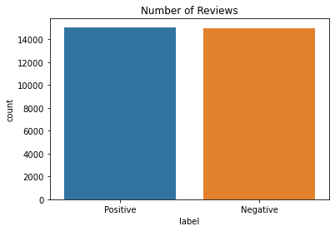
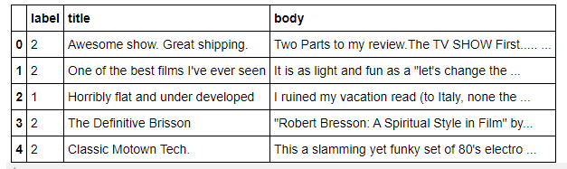
Data overview
Data source: https://www.kaggle.com/kritanjalijain/amazon-reviews
Original data set has 2 million customer reviews on Amazon. A subset of 30,000 reviews were used for this study.
Target: label (1-negative, 2-postive, 50/50 split)
Feature: review title, review body

Slide 8
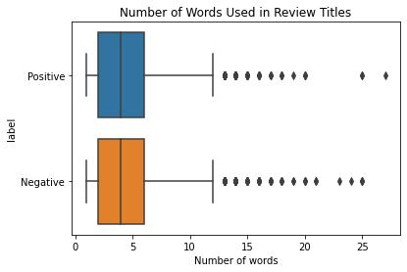
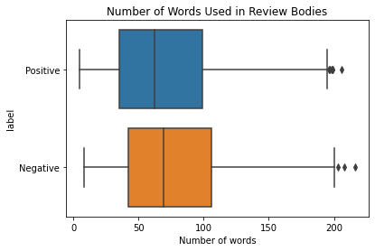
Review length
Review title
Most review titles are 2-6 words long.
There isn’t obvious difference between positive and negative reviews in terms of review length.
Review body
Most review bodies are 30-110 words long.
An interesting fact is that negative reviews tend to be a little longer than positive reviews.

Slide 9
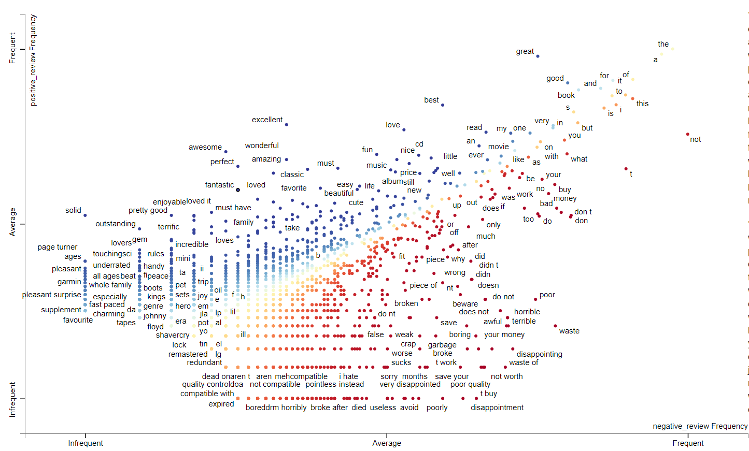
Word frequency in negative vs positive reviews
On the bottom right, words appear more frequently in negative reviews, such as ‘disappointment’, ‘poor’, etc.
On the upper left, words appear more frequently in positive reviews, such as ‘solid’, ‘awesome’, etc
The scatter points are denser when they are close to bottom left, which means there’re more infrequent words than frequent words.

Slide 10
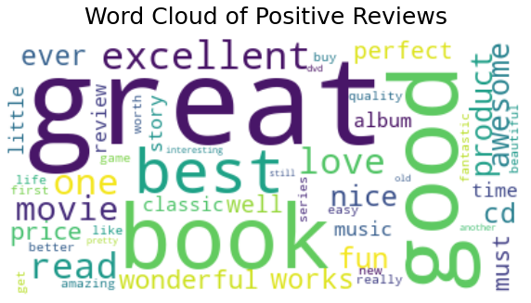
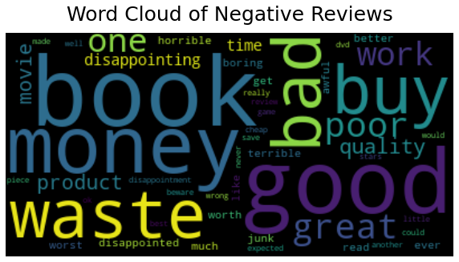
Word cloud
Two word cloud maps are generated to show the 50 most frequent words in positive and negative review titles.
Unlike the scatter text plot before, the word cloud maps don’t show the relative frequency of a word in positive reviews comparing to negative reviews.
Some words just appear a lot in both types of reviews, such as book, good, buy, read, etc.

Slide 11
Modeling

Slide 12
modeling
Data preprocessing
Tokenization
Count vectors
Sequentialization and padding (RNN)
Training / Test data split
Training set – 20,000 reviews
Model fitting
Naïve Bayes
Test set – 10,000 reviews
Logistic Regression
Random Forest
RNN
Model prediction and validation
Accuracy
Run time

Slide 13
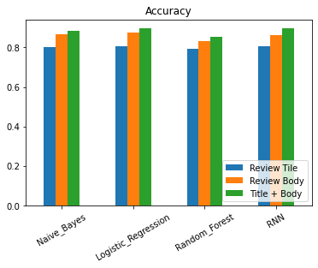
Performance summary
The accuracy ranges from 0.79 to 0.90.
Using review body for inputs has better result than using review title alone.
The performance of all models seem to be very close without much hyperparameter tuning done.
Model run time can vary greatly depending on the method picked and parameter setting.
 | Model_Accuracy (Title) | Model_Accuracy (Body) | Model_Accuracy (Title&Body) | Model_Run_Time (secs)
Naive_Bayes | 0.79988 | 0.866187 | 0.883888 | 0.212183
Logistic_Regression | 0.805681 | 0.874487 | 0.89539 | 12.955616
Random_Forest | 0.794279 | 0.832683 | 0.855586 | 78.578343
RNN | 0.805381 | 0.862886 | 0.89529 | Depending on epochs

Slide 14
FUTURE research
Additional data preprocessing is definitely worth exploring, such as misspelling correction, stemming and lemmatizing, etc.
Hyperparameter tuning isn’t implemented in this study. As a result, the performance achieved is likely not close to optimal. It’s strongly recommended to incorporate tuning as a future exploration topic.
It’s recommended to extend the training set to the original data set that has 2 million reviews, which is a lot more than what this study uses. It’s expected that the accuracy can increase to some extent with more training data.

Slide 15


Contact
LinkedIn https://www.linkedin.com/in/mike-shi-pe-cem-14029a26/
GitHub https://github.com/stonewatertx
Email stonewatertx@email.com

